Slide 1



Customer Churn Prediction System
Yasser Al-Ghamdi
Mohammed Al-Hajli
Mishari
Nawaf Zakri

Slide 2






1. Introduction
What is Customer Churn?
Project Objective
Customer churn occurs when a subscriber stops using a company’s service. Retaining existing customers is critical as it directly supports long-term sustainable business growth.
Develop an end-to-end Deep Learning model to predict whether a telecom customer will churn or stay based on demographics, accounts, services, contracts, and charges.

Slide 3




2. Key Challenges & Problems
Business & Financial Impact
Class Imbalance & Data Complexity
High customer churn significantly reduces recurring revenue and lowers total Customer Lifetime Value (LTV) in competitive telecom markets.
The dataset contains mixed numerical and categorical features with heavy class imbalance (far more customers stay than churn), making standard detection difficult.

Slide 4
3. Proposed Solutions
Data Preprocessing & Encoding: Clean raw data, convert categorical columns into machine-learning format via One-Hot Encoding, and scale numerical variables.
Class Weighting: Apply weighted loss functions during training to prioritize detecting minority churn instances without ignoring standard cases.
Overfitting Prevention: Incorporate L2 Regularization, Dropout layers, and Early Stopping to build a robust model that generalizes well on unseen test data.

Slide 5

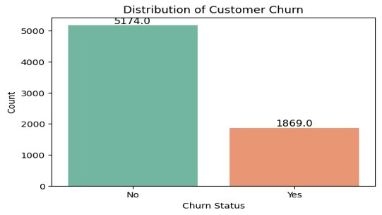
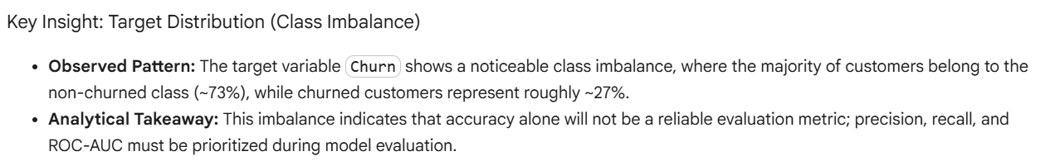
4. Exploratory Data Analysis (EDA)

Slide 6
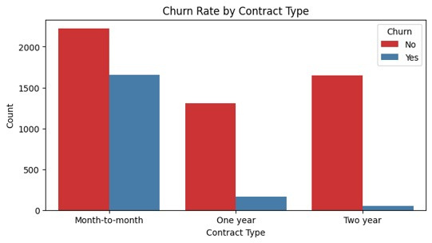
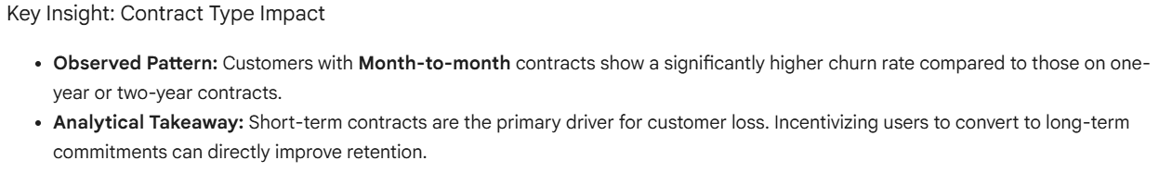
4. Exploratory Data Analysis (EDA)

Slide 7
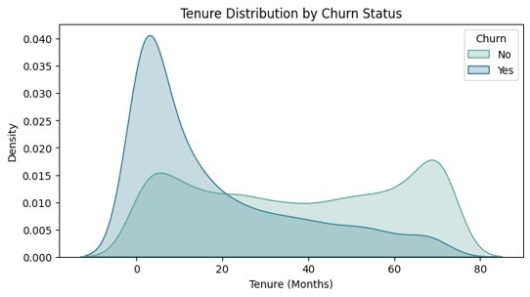
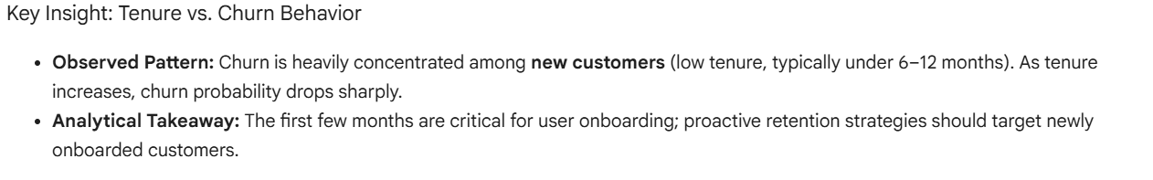
4. Exploratory Data Analysis (EDA)

Slide 8


5. Data Preprocessing Pipeline
Data Cleaning & Scaling
Data Splitting & Integrity
Cleaned missing values in TotalCharges.
Separated predictor features from the Churn target.
Applied One-Hot Encoding for categorical attributes.
Partitioned into Train, Validation, and Test sets.
Standardized numerical attributes using StandardScaler.
Strict pipeline construction to prevent data leakage.

Slide 9


6. Deep Learning Architecture
ANN Structure
Optimization
Regularization
Artificial Neural Network (ANN) featuring two hidden dense layers with ReLU activation functions.
Trained with Adam optimizer and Binary Cross-Entropy loss with added class weights.
Dropout, L2 Regularization, and Early Stopping to monitor validation and prevent overfitting.

Slide 10





7. Performance & Results
0.8438
0.8180
0.78
Neural Network Test AUC
Random Forest Test AUC
Churn Recall Rate
Outperformed Baseline
Baseline Model
High Sensitivity
• Detailed Churn Metrics: Precision: 0.54 | Recall: 0.78 | F1-Score: 0.63
• Business Value: High recall ensures the system successfully captures a vast majority of actual churners, allowing proactive retention intervention.

Slide 11

8. Executive Summary
End-to-End System: Successfully designed and deployed an automated customer churn prediction framework.
Data-Driven Insights: EDA revealed crucial business drivers, confirming contract types and tenure as key churn indicators.
Superior Performance: Deep Learning (ANN) achieved superior performance (AUC 0.8438) over classic Machine Learning baselines.
Actionable Retention: Enables telecom marketing teams to identify high-risk customers early and offer targeted incentives.

Slide 12



9. Live Application & Q&A
Interactive Streamlit Demo
Test the churn prediction model live with interactive customer parameters:
Open Streamlit Web App
Thank You!
Any Questions or Comments?

